Slide 1


Deep-Work Lab

Slide 2



About
Shoonyas is a unique blend of Management Consulting & Leadership Coaching enabling mid-size organizations to solve their critical problems and scale up their businesses.
"We are here to challenge the status quo"
Strategy Consulting
Leadership Development
Health & Wellness
For more: www.shoonyas.com

Slide 3
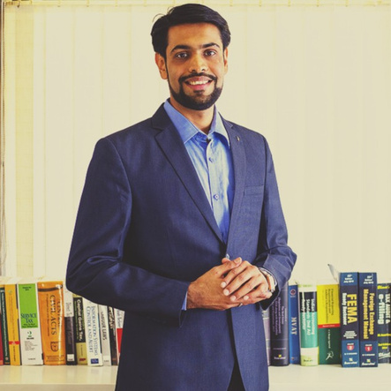

Founder & CEO
Mr. Meghnand Dungarwal
  Certified Executive Coach, CA, CPA (USA), CISA
  Featured in The CEO Magazines list of "20 Most Inspiring Business Management & Strategic Consultant to watch in 2023"
  18 years professional consulting experience (incl Big4s)
  On the 'Coach Panel' of prestigious organizations
  Professional Speaker internationally
  Author of ‘The Simple Path to Freedom & Success’
  Educator of online course ‘From Clutter-to-Clarity’

Slide 4
From Fear to Success
How to Overcome Exam, Interview, and Career Anxiety?

Slide 5

"Decide that you want it more than you are afraid of it."

Slide 6
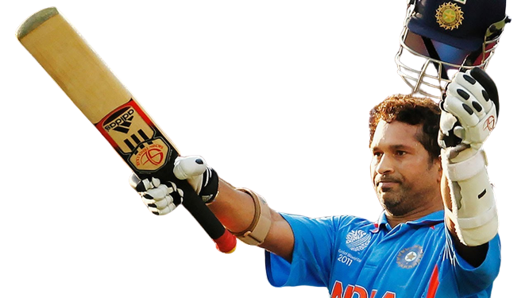
Sachin Tendulkar (Cricketer)
He once said in an interview that he used to get very nervous before exams and felt like he was going to forget everything he had learned. He even faced anxiety and sleepless nights in his career.
Despite this fear, he remained focused on his passion for cricket and worked hard to become one of the most successful and admired athletes in the world.

Slide 7
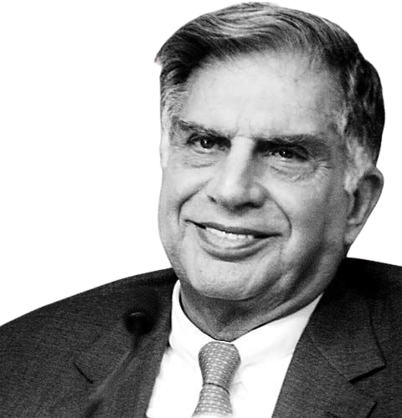
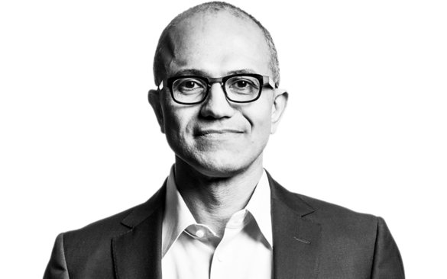
Ratan Tata (Chairman Tata Group)
He was a slow learner and was often teased by his classmates, which affected his confidence and self-esteem.
Satya Nadella (CEO of Microsoft)
He initially struggled to adapt to American culture and faced many barriers in his early career.
Despite facing these challenges, Ratan Tata employed a strategy of focusing on his strengths and interests instead of his weaknesses, while also surrounding himself with supportive individuals who believed in his abilities
He has used mindfulness and meditation techniques to overcome his fears and build his confidence.

Slide 8
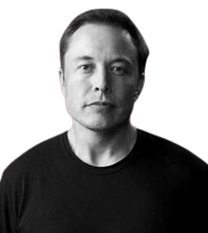
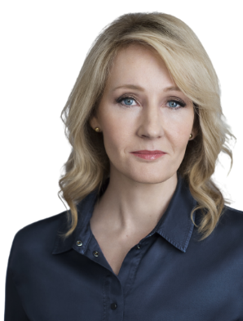
J.K. Rowling (British Author)
The author of the Harry Potter series, Rowling had fear of failure when writing her first book (Harry Potter and the Philosopher's Stone).
Elon Musk (CEO SpaceX & Tesla)
The CEO of SpaceX and Tesla had lots of internal fears.
He overcame his fear of failure by focusing on the long-term vision for his companies. He also relied on his problem-solving skills and perseverance to overcome challenges and setbacks.
J.K. Rowling's deep work strategies enabled her to create some of the most cherished books of our era, illustrating how deep work can enhance productivity and achievement.

Slide 9

Inner Dialogue
  What if I don't know the answer to their questions?
  Why do I feel like I'm not good enough for this job?
  "What if I forget everything I studied?"
  What if I fail this exam?
  What if I can't find a job after graduation?
  What if I choose the wrong career path?

Slide 10

Understanding Fear
  Fear is a natural emotion that arises when we perceive a threat or danger, either real or imagined
  It can manifest in physical symptoms such as increased heart rate, sweating, and trembling.
  However, fear can also be irrational & hold us back from achieving our goals

Slide 11
F - False
E - Evidence
F.E.A.R. stands for
A - Appearing
R - Real

Slide 12
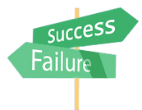




Understanding the Root Causes
Pressure to perform
Unclear expectations
Fear of failure
Self-doubt
Lack of control
Feeling pressure to perform well in exams, secure a good job, or ace an interview
Fearing failure and the consequences that may come with it, such as disappointment, shame, or a setback in career goals
Doubting self abilities, qualifications, or preparation, which can undermine their confidence
Feeling like I have limited control over the outcome of exams, job interviews, or career decisions
Not fully understanding the expectations or requirements for a particular exam, job, or career path

Slide 13
Why it's important in today's world

Slide 14
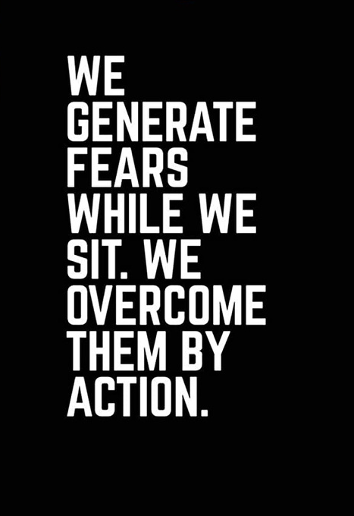
Enhanced
Self-Esteem
Increased Performance
Greater Resilience
Better Decision Making
Improved Communication

Slide 15

Strategies To Overcome Fear

Slide 16







Exam Fear
Positive Self Talk
Stay Organized
Focus On The Present
Avoid Overstretching
Birds Eye View - Revision
Visualize Success
Deep Breathing & Smile

Slide 17






Interview Fear
Be CLEAR Within Yourself
Practice The Mock Interviews
Research The Company
Dress For Success
Listen Carefully
Deep Breath & Smile

Slide 18



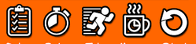


Career Fear
Be CLEAR About Your Goals
Learn New Skills
Identify The Root Of Fear
Learn From Past Experience
Expand Your Network
Seek Mentorship

Slide 19
F.E.A.R. Has Two Meaning:
'Forget Everything and Run'
OR
'Face Everything And Rise'.
The Choice is Yours.

Slide 20
WISH YOU
ALL THE BEST!

Slide 21
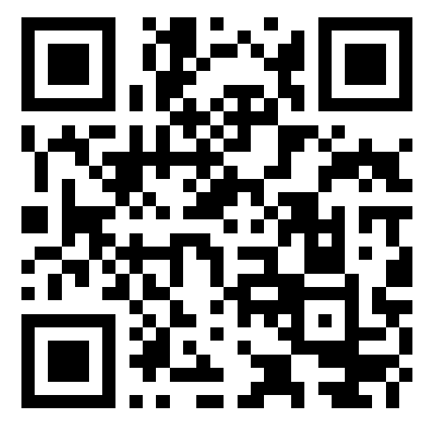
Session Feedback

Slide 22
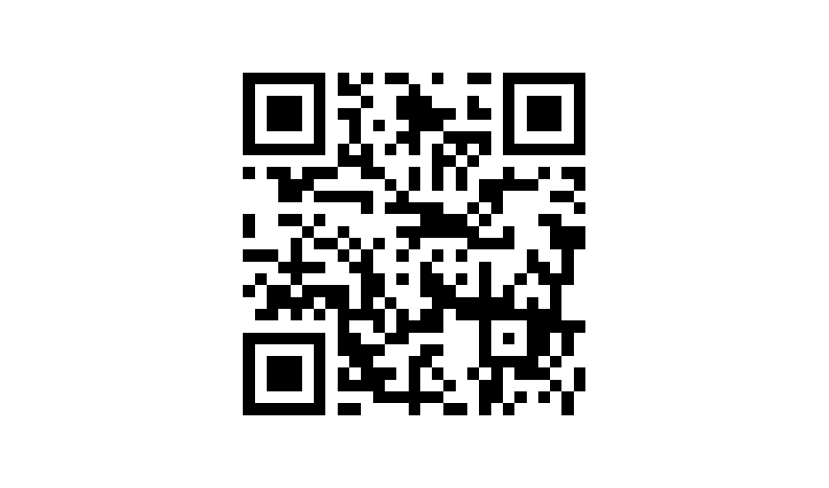
Google Review

Slide 23

Experience Shoonyas
Experience Results
WEBSITE
EMAIL
OFFICE - SERVING GLOBALLY
www.shoonyas.com
meghnand@shoonyas.com
Shoonyas - Deep Work Lab
5, Ram Nivas, Lulla Nagar,
Pune – 411040

